Slide 1
BUS MANAGEMENT
Name: NishaDevi S
Enroll no: EBEON1122696093
Project Name: Blue Bus
Trainer Name: JANANI V

Slide 2
OVERVIEW
we will learn about how to develop a full stack web application that is basic Bus Management Service Application using Angular 10 and Spring Boot.
Create Bus Detail
Displaying list of Bus Details
Update Bus details
Delete Bus details
View particular Bus details
Search Bus using starting point
View Ac and Non-Ac Bus list

Slide 3
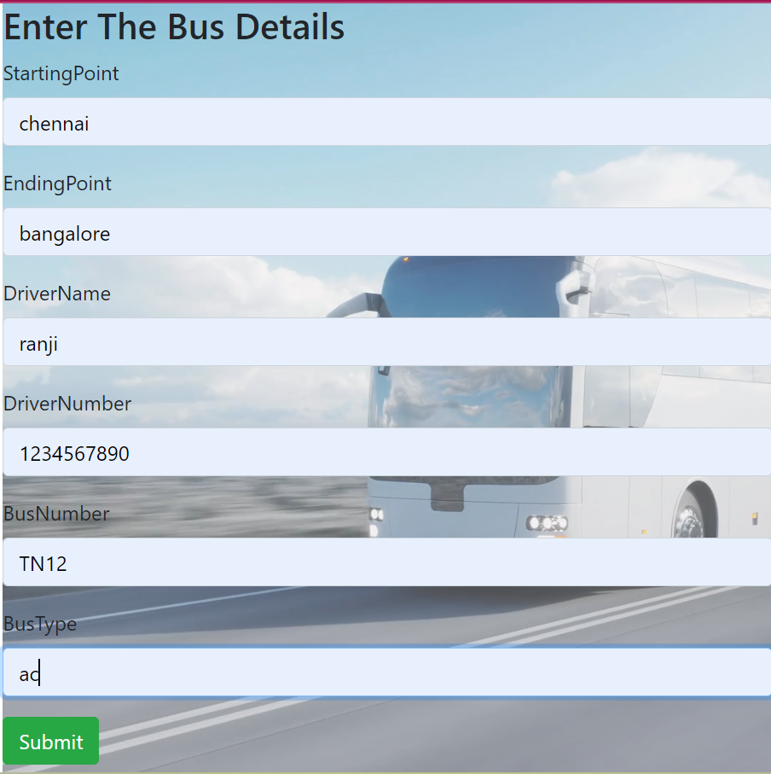
Output For Reference: Create Bus Detail

Slide 4
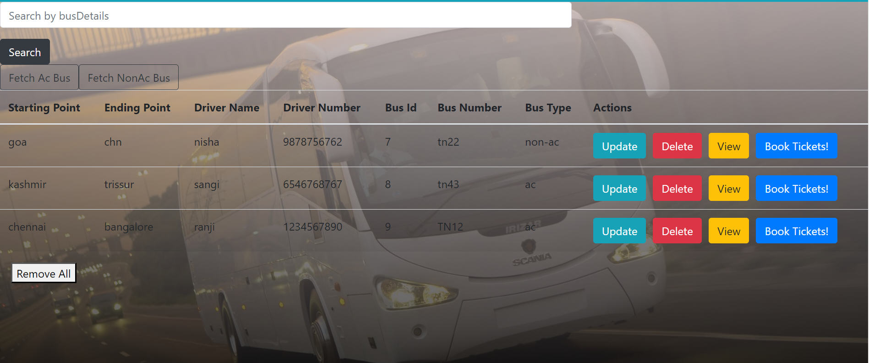
Bus Details List:

Slide 5
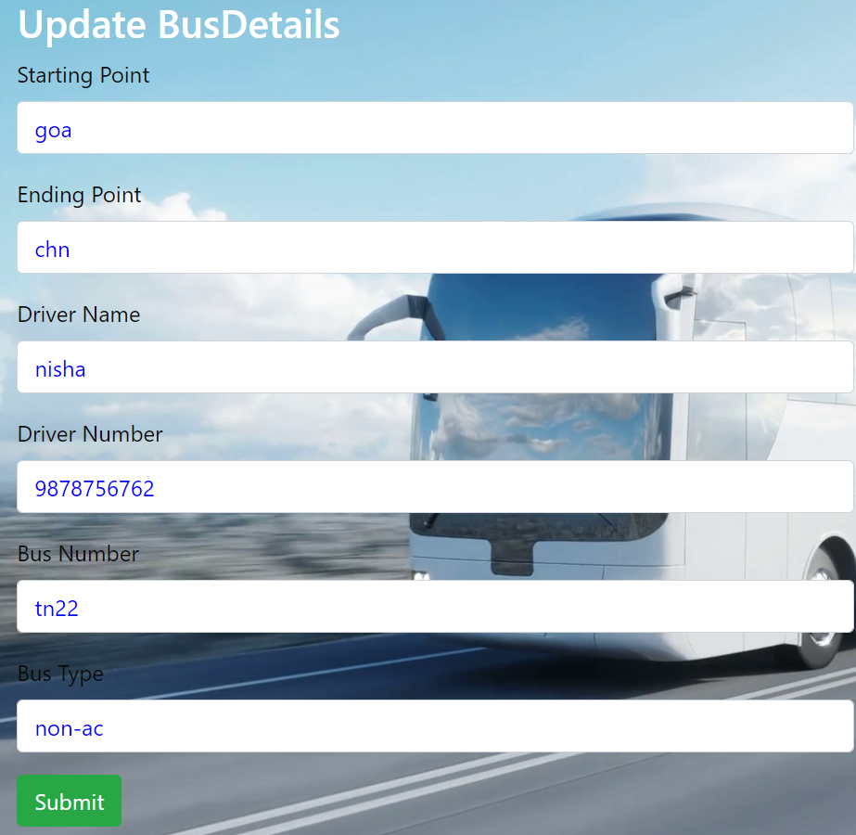
Update Bus Details:

Slide 6
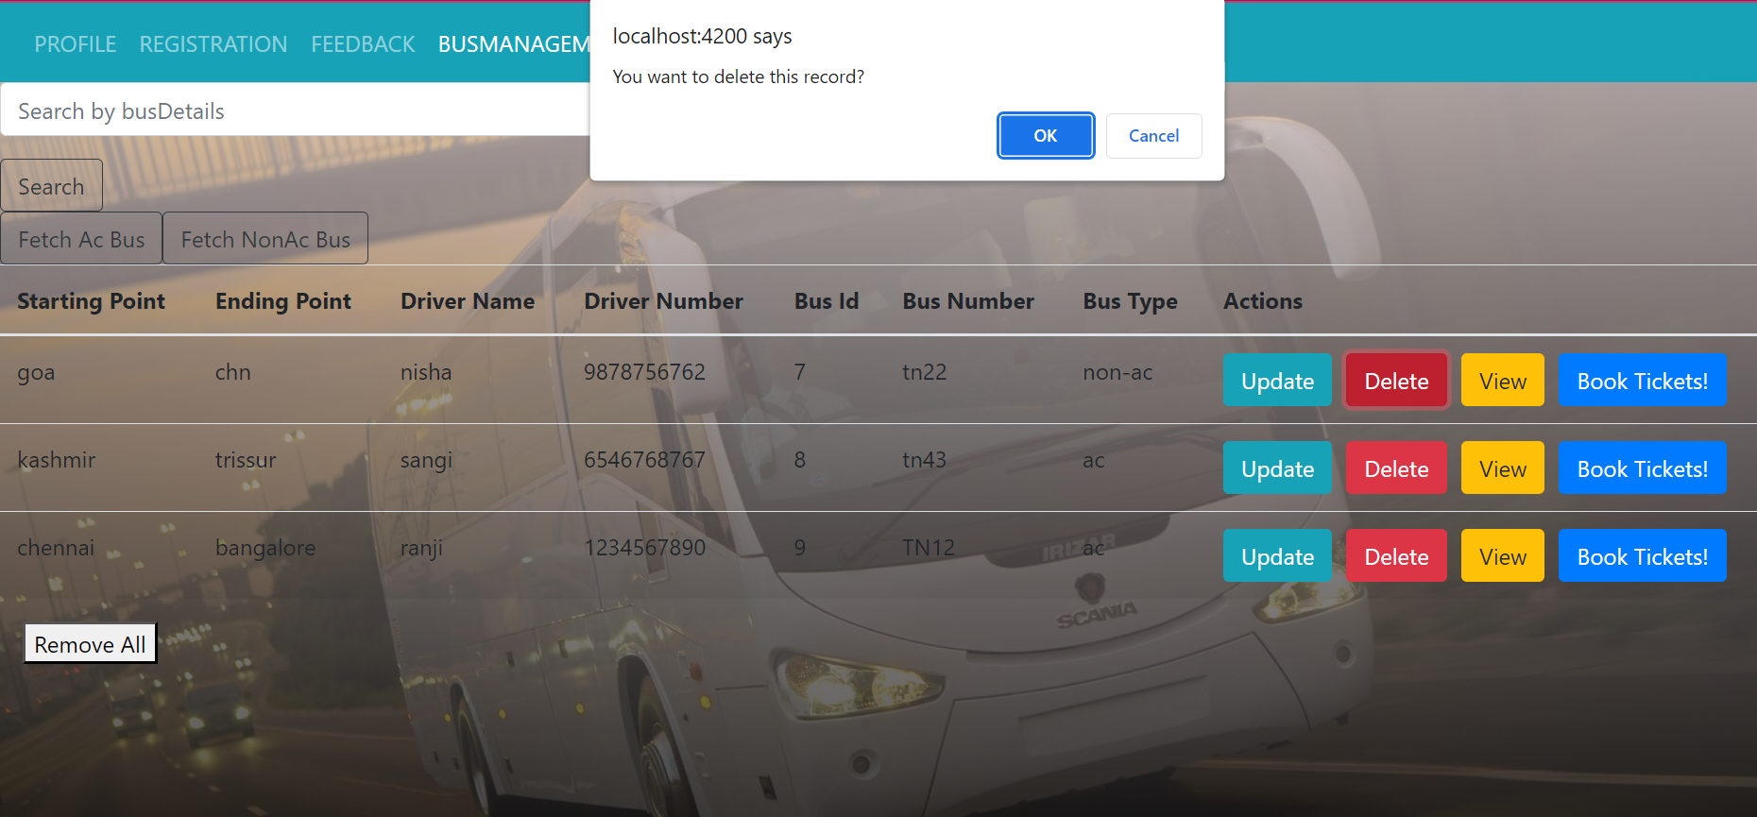
Delete Bus Details:

Slide 7
TECHNOLOGIES USED
BACK END
FRONT END
DATABASE
JAVA HIBERNATE SPRING REST API
HTML CSS JAVASCRIPT BOOTSTRAP CSS ANGULAR
MYSQL

Slide 8
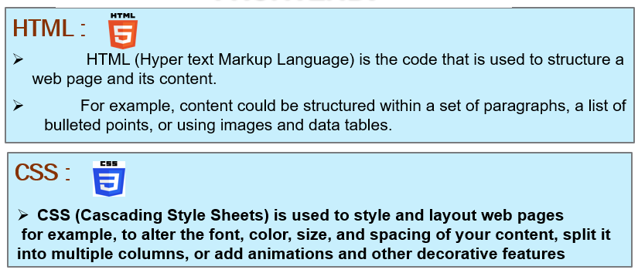
FRONT END

Slide 9
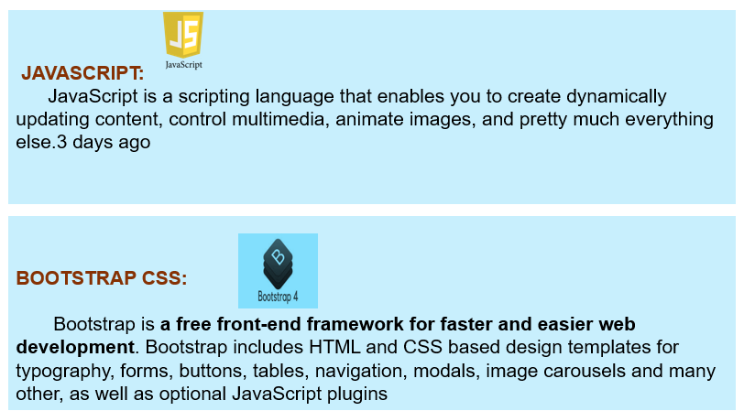

Slide 10
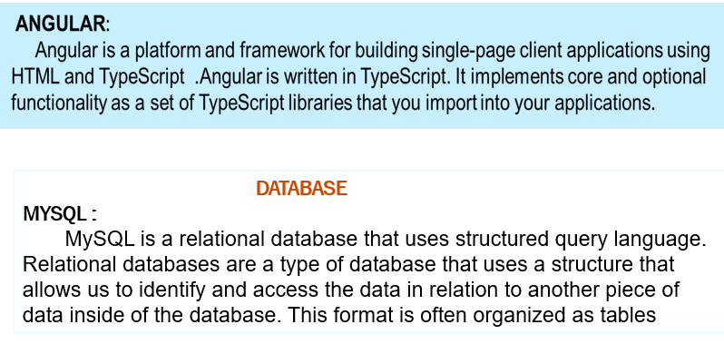
HTML

Slide 11
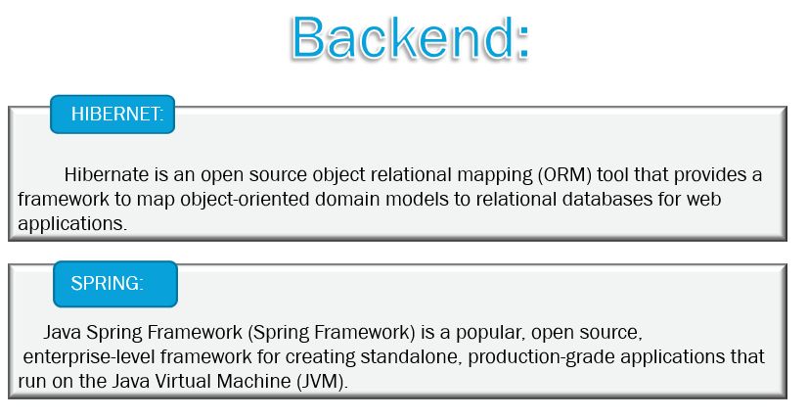
css

Slide 12
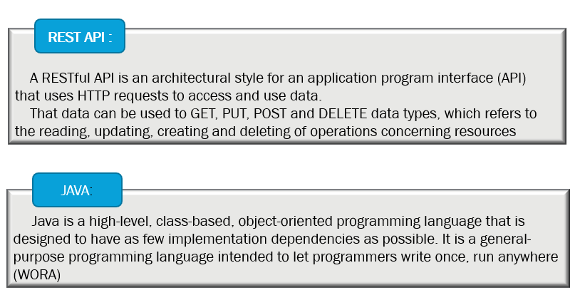
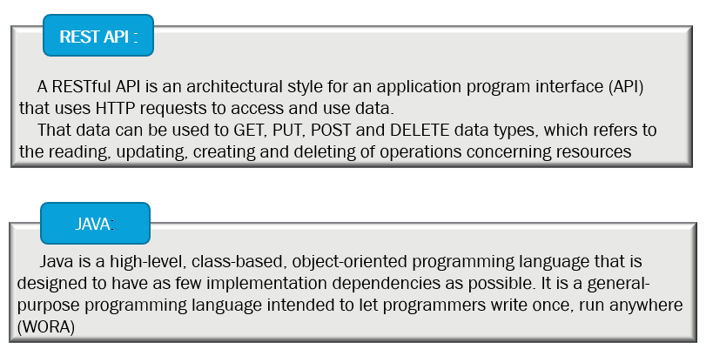

Slide 13
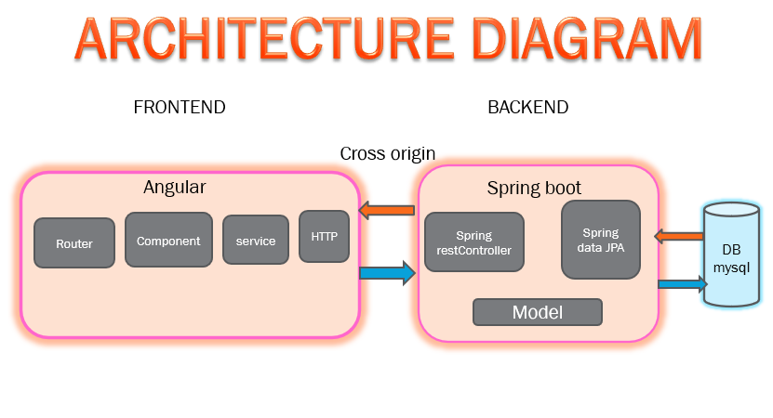
BOOTSTRAPCSS

Slide 14
Backend Flow (Spring boot):
What happened when the spring boot application run?
If you click run spring boot application . The main application context is kicked off which in turn searches for the classes annotated with @Configuration, initializes all the declared beans in those configuration classes, and based upon the scope of those beans, stores those beans in JVM, specifically in a space inside JVM which is known as IOC container. After the creation of all the beans, automatically configures the dispatcher servlet and registers the default handler mappings, message Converts, and all other basic things.
spring boot supports three embedded servers:-
Tomcat (default), Jetty and Undertow.

Slide 15
JAVASCRIPT
Explanation:
The Client makes an HTTP request(GET, PUT, POST, etc.)
The HTTP request is forwarded to the Controller. The controller maps the request. It processes the handles and calls the server logic.
The business logic is performed in the Service layer. The spring boot performs all the logic over the data of the database which is mapped to the spring boot model class through Java Persistence Library(JPA).
The JSP page is returned as Response from the controller.

Slide 16
Frontend flow(Angular):
Tool used:
Using Angular we have done Frontend.
Explanation:
Before Starting the Angular server we have to run Spring Boot Application.
When the server is Started in Angular first it comes into index.html. In index.html there is an App root it went to app module and
app Component . ts(app .component . html , app .component .css) and then it goes to app.routing.module.ts(path is given for all the sub components).
After that we have to create Subcomponent like create.update,list,view,login,logout,feedback,homepage,etc….
By Using these subcomponent there is service class in that we have to give base Url to connect backend Using @crossorgin annotation in service class.

Slide 17
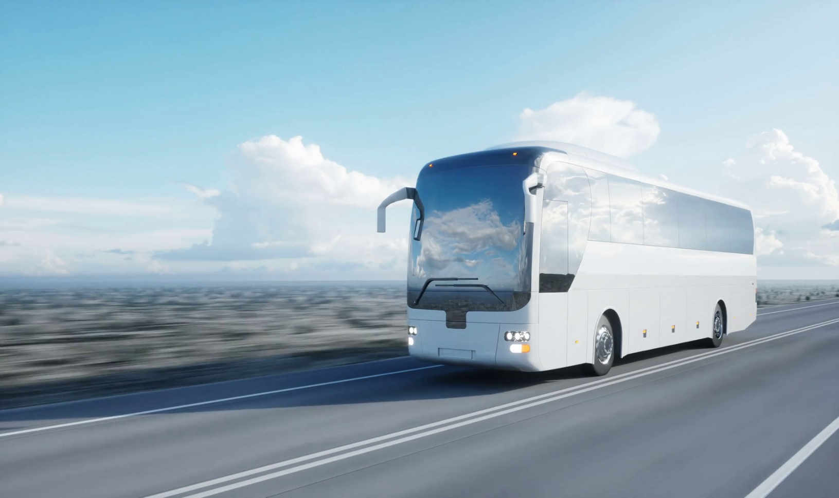
THANK YOU.....

